Slide 1
DYNAMIC PROGRAMMING
Design & Analysis of Algorithm (CS-2009) Course Supervisor : ANAUM HAMID

Slide 2
Dynamic Programming
Dynamic Programming is a general algorithm design technique for solving problems defined by recurrences with overlapping subproblems
Invented by American mathematician Richard Bellman in the 1950s to solve optimization problems and later assimilated by CS
“Programming” here means “planning”
Main idea:
set up a recurrence relating a solution to a larger instance to solutions of some smaller instances
solve smaller instances once
record solutions in a table
extract solution to the initial instance from that table

Slide 3
Algorithmic Paradigms
Divide-and-conquer. Break up a problem into two sub-problems, solve each sub-problem independently, and combine solution to sub-problems to form solution to original problem.
Dynamic programming. Break up a problem into a series of overlapping sub-problems, and build up solutions to larger and larger sub-problems.
Dynamic programming is efficient in finding optimal solutions for cases with lots of overlapping sub-problems.

Slide 4
Divide-and-conquer
Divide-and-conquer method for algorithm design:
Divide: If the input size is too large to deal with in a straightforward manner, divide the problem into two or more disjoint subproblems
Conquer: conquer recursively to solve the subproblems
Combine: Take the solutions to the subproblems and “merge” these solutions into a solution for the original problem

Slide 5
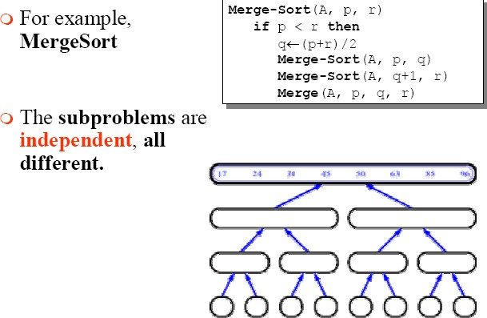
Divide-and-conquer - Example

Slide 6
Dynamic programming
Dynamic programming is a way of improving on inefficient divide-
and-conquer algorithms.
By “inefficient”, we mean that the same recursive call is made over and over.
If same subproblem is solved several times, we can use table to store result of a subproblem the first time it is computed and thus never have to recompute it again.
Dynamic programming is applicable when the subproblems are
dependent, that is, when subproblems share subsubproblems.
“Programming” refers to a tabular method

Slide 7
Difference between DP and Divide- and-Conquer
Using Divide-and-Conquer to solve these problems is inefficient because the same common subproblems have to be solved many times.
DP will solve each of them once and their answers are stored in a table for future use.

Slide 8
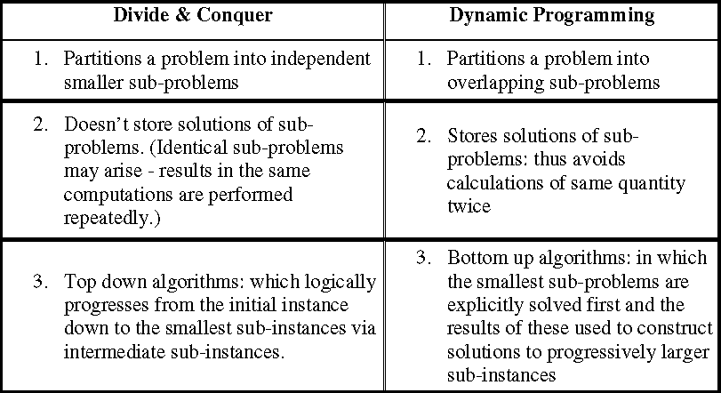
Dynamic Programming vs. Recursion and Divide & Conquer

Slide 9
Elements of Dynamic Programming (DP)
DP is used to solve problems with the following characteristics:
Simple subproblems
We should be able to break the original problem to smaller subproblems that have the same structure
Optimal substructure of the problems
The optimal solution to the problem contains within optimal solutions to its subproblems.
Overlapping sub-problems
there exist some places where we solve the same subproblem more than once.

Slide 10
Dynamic Programming Approaches
DYNAMIC PROGRAMMING
MEMOIZATION (TOP-DOWN APPROACH)
TABULATION (BOTTOM UP APPROCH)

Slide 11
Steps to Designing a Dynamic Programming Algorithm
Characterize optimal substructure
Recursively define the value of an optimal solution
Compute the value bottom up
(if needed) Construct an optimal solution

Slide 12
Principle of Optimality
The dynamic Programming works on a principle of optimality.
Principle of optimality states that in an optimal sequence of decisions or choices, each sub sequences must also be optimal.

Slide 13
Example 1: Fibonacci numbers
Recall definition of Fibonacci numbers:
F(n) = F(n-1) + F(n-2) F(0) = 0
F(1) = 1
Computing the n^{th} Fibonacci number recursively (top-down):
F(n)
F(n-1)
+
F(n-2)
F(n-3) +
...
F(n-2) + F(n-3)
F(n-4)

Slide 14
Fibonacci Numbers
Fn= Fn-1+ Fn-2 n ≥ 2
F0 =0, F1 =1
0, 1, 1, 2, 3, 5, 8, 13, 21, 34, 55, …
Straightforward recursive procedure is slow!
Let’s draw the recursion tree

Slide 15
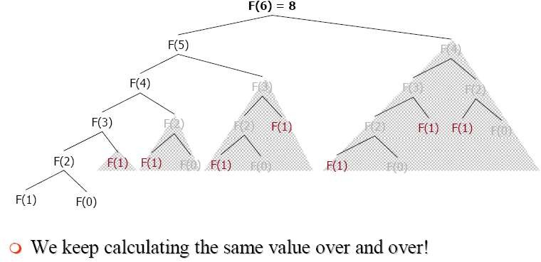
Fibonacci Numbers (Memoiztion)

Slide 16
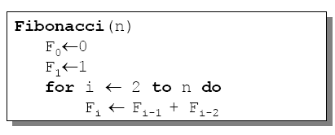
Fibonacci Numbers (Tabulation)
We can calculate Fn in linear time by remembering solutions to the solved subproblems – dynamic programming
Compute solution in a bottom-up fashion
In this case, only two values need to be remembered at any time

Slide 17
Dynamic Programming Algorithm Examples
Edit Distance
1/0 Knapsack problem
CHAIN MATRIX MULTIPLICATION

